Slide 1
HIPs Ear sorting
Huyu Liu
11/23/2022

Slide 2
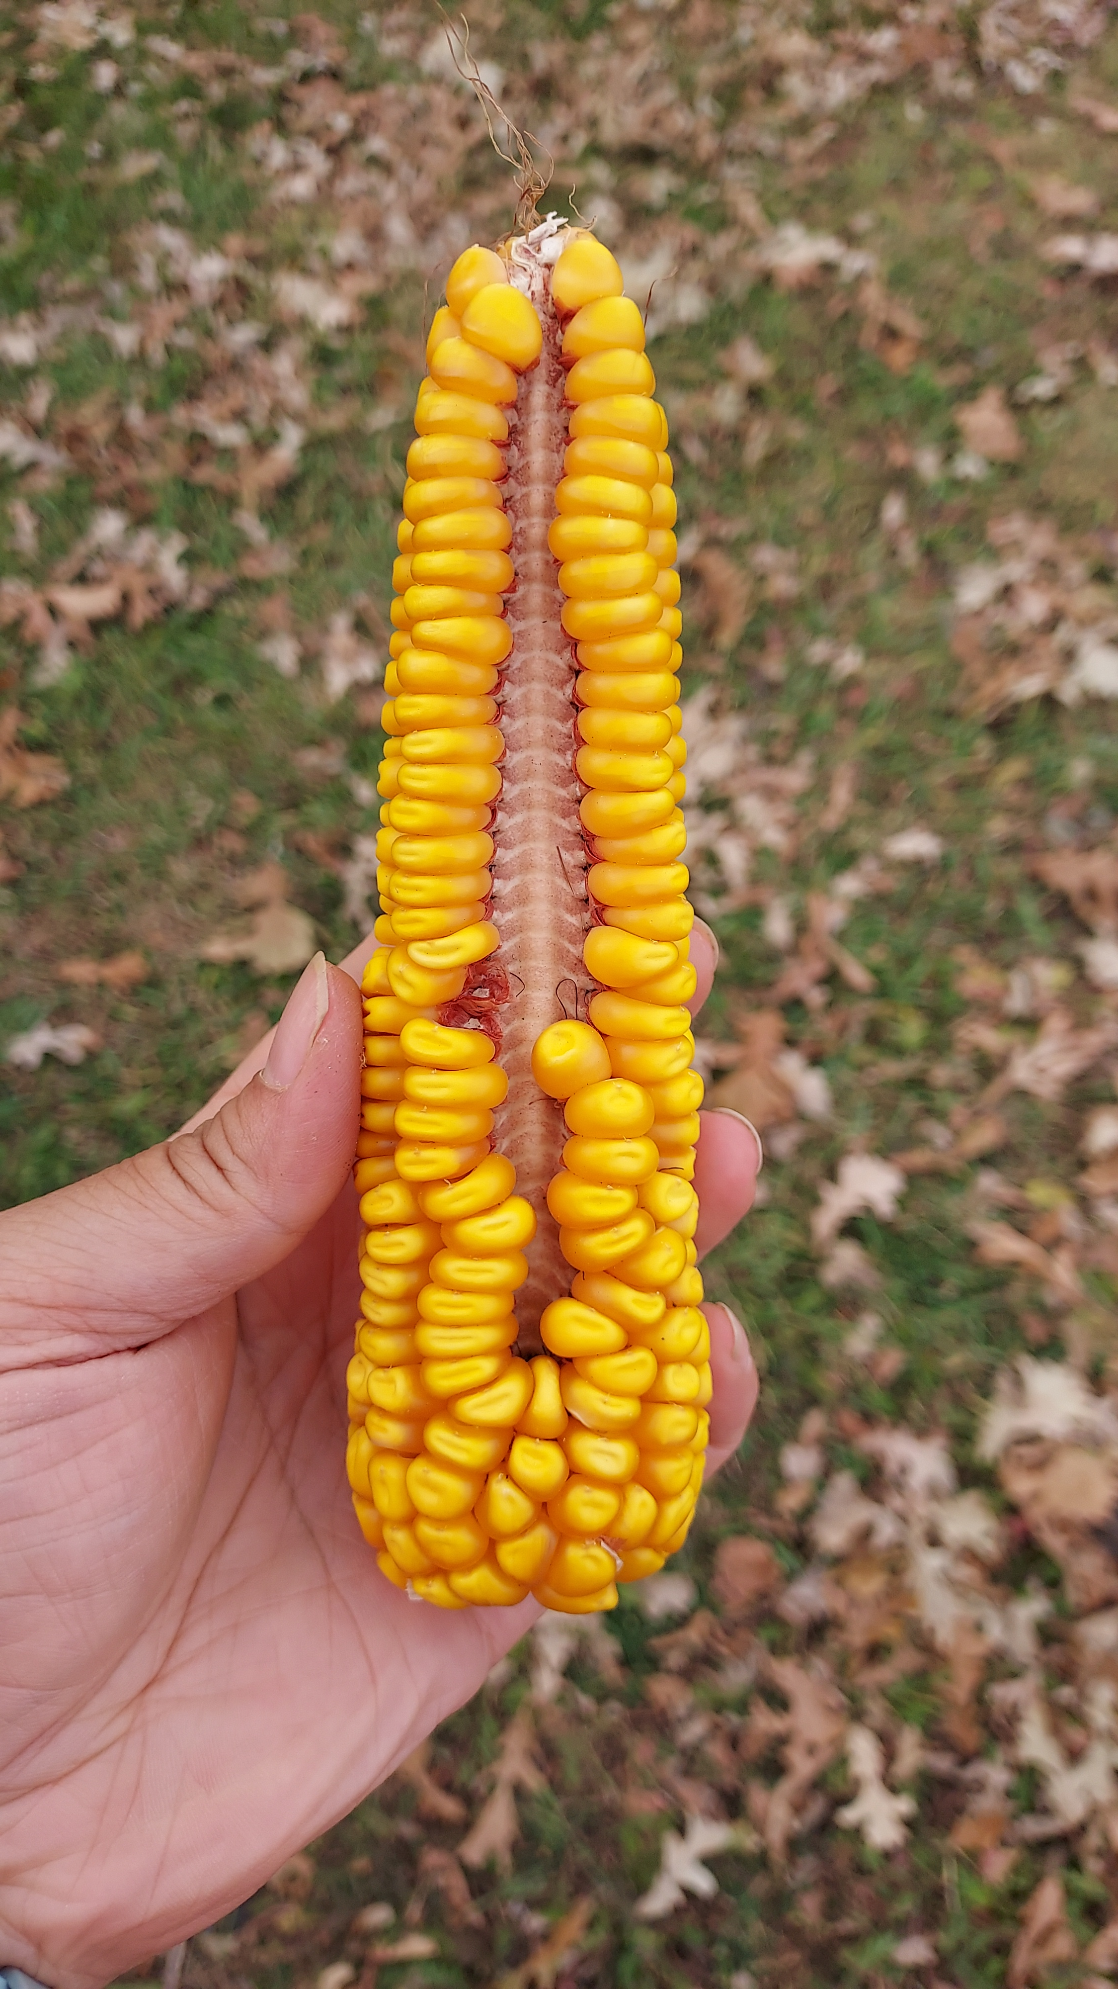
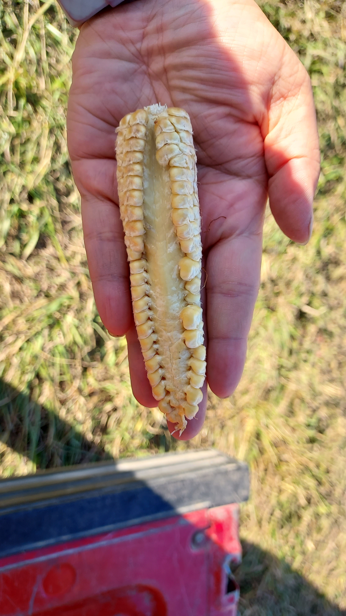
Ovule problem
Gap area: very smooth surface, impossible to grow seeds.
Normal area that has ability to grow seeds.

Slide 3
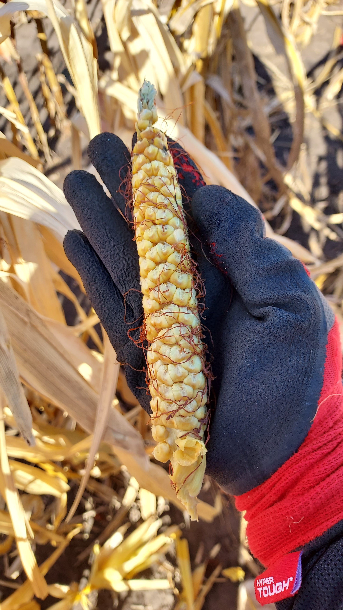
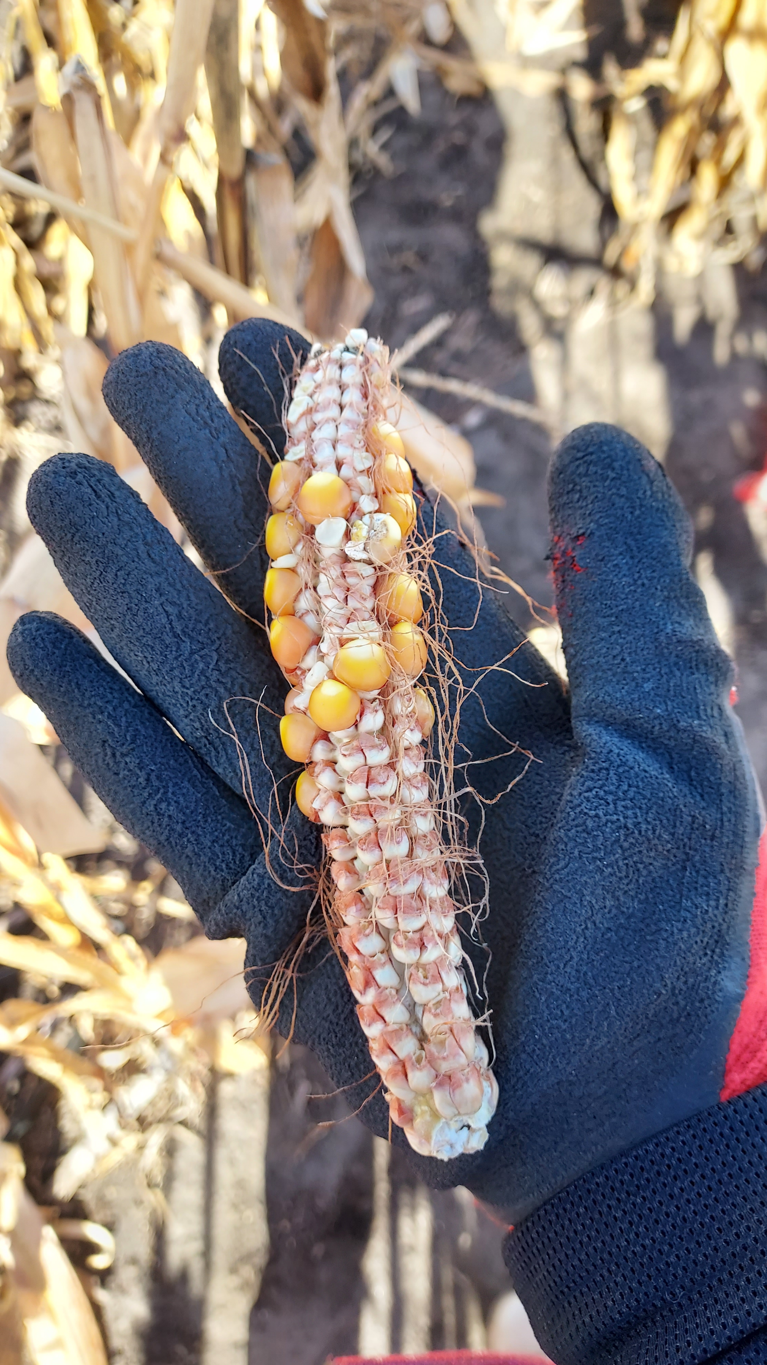
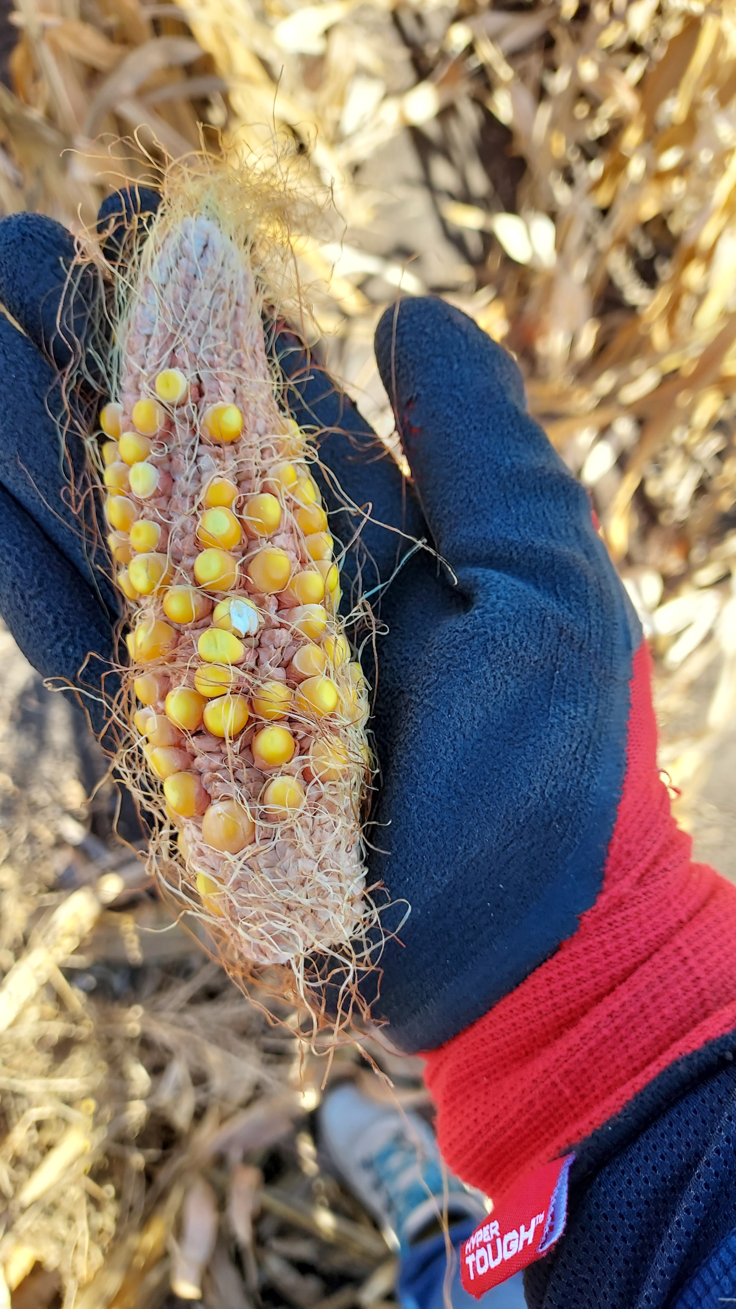
Set aside
Ears with significantly <50% seeds available.

Slide 4
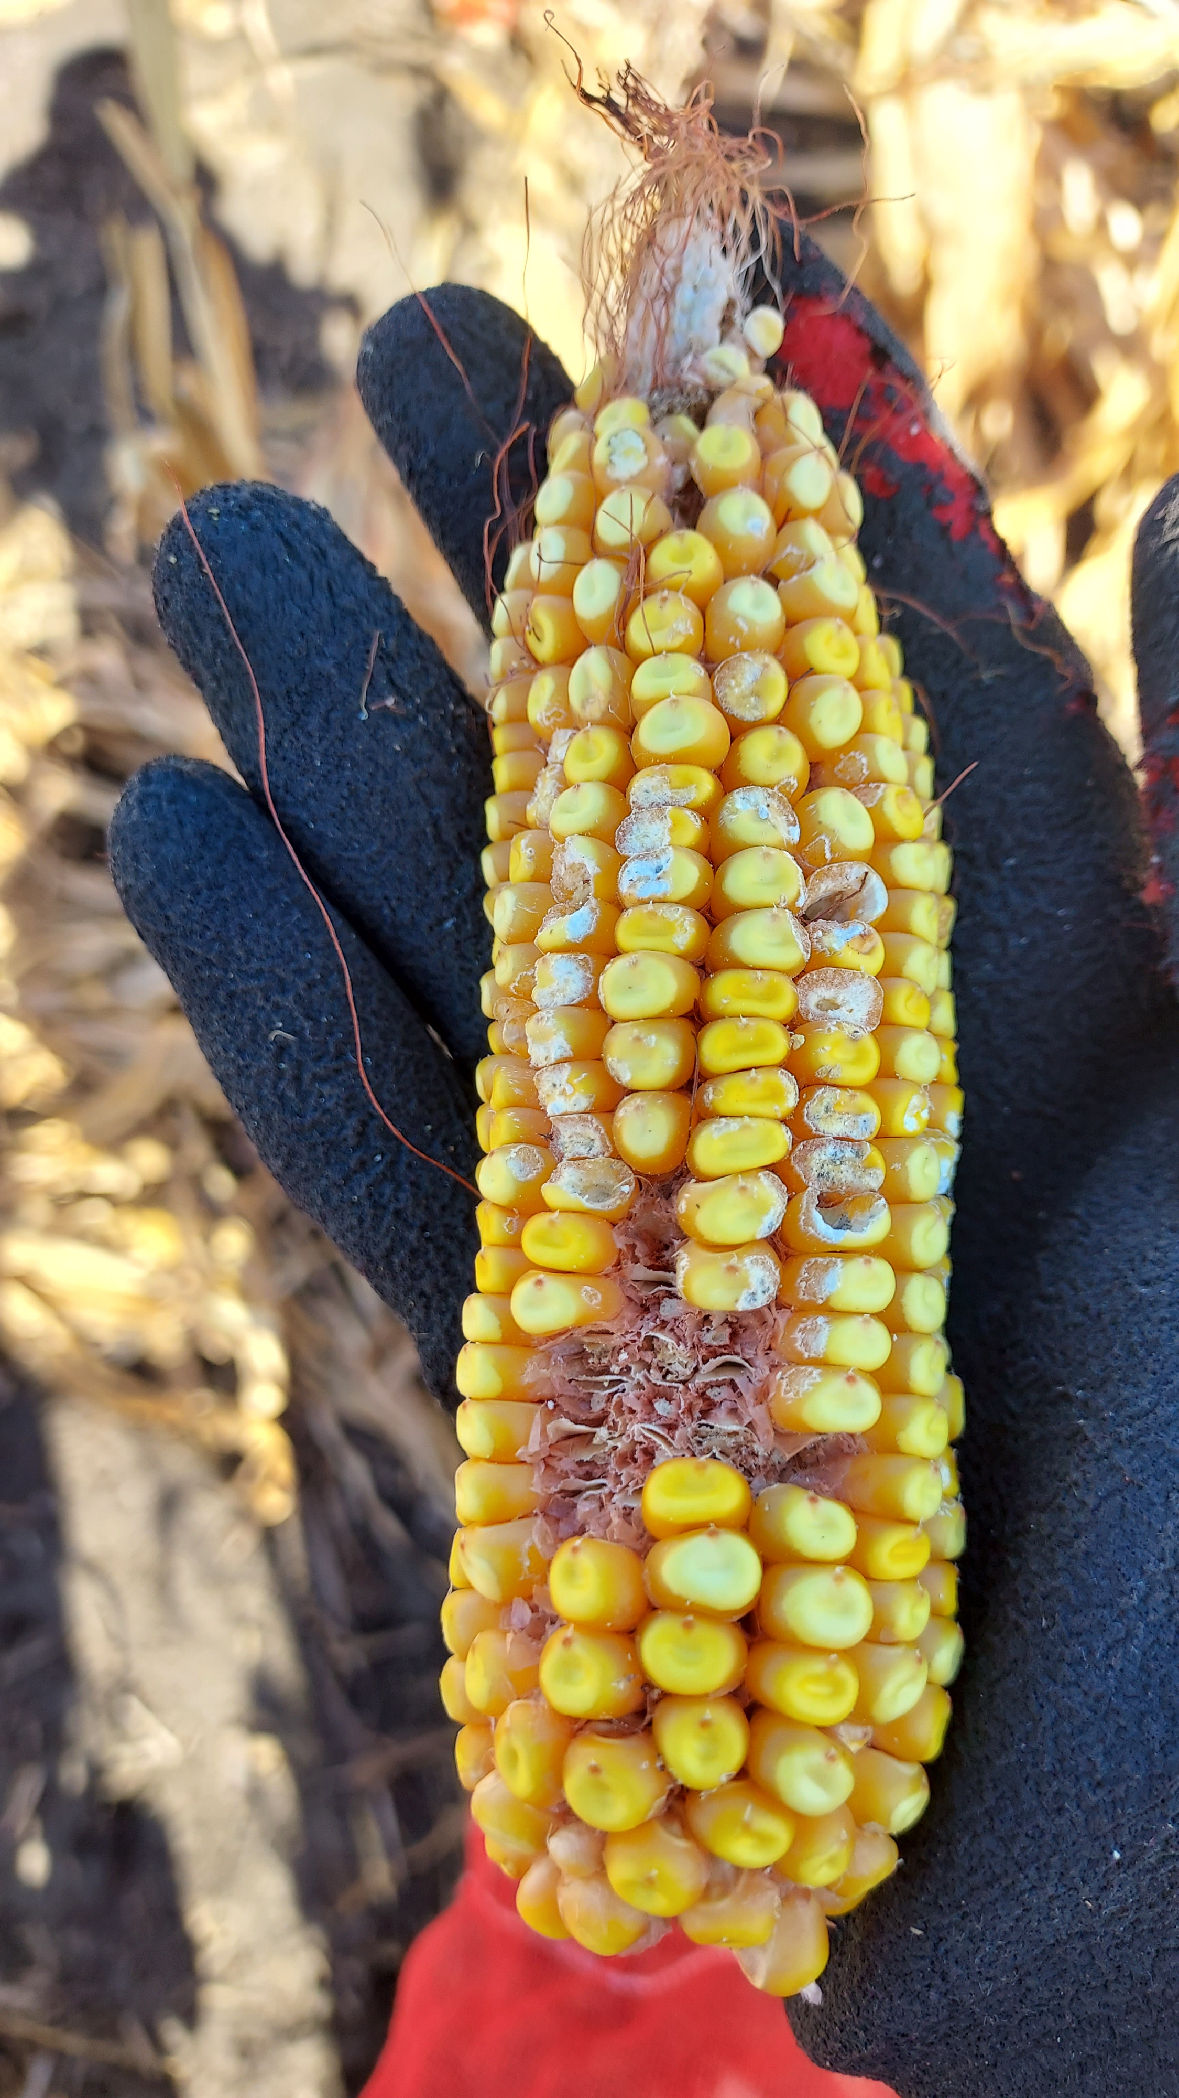
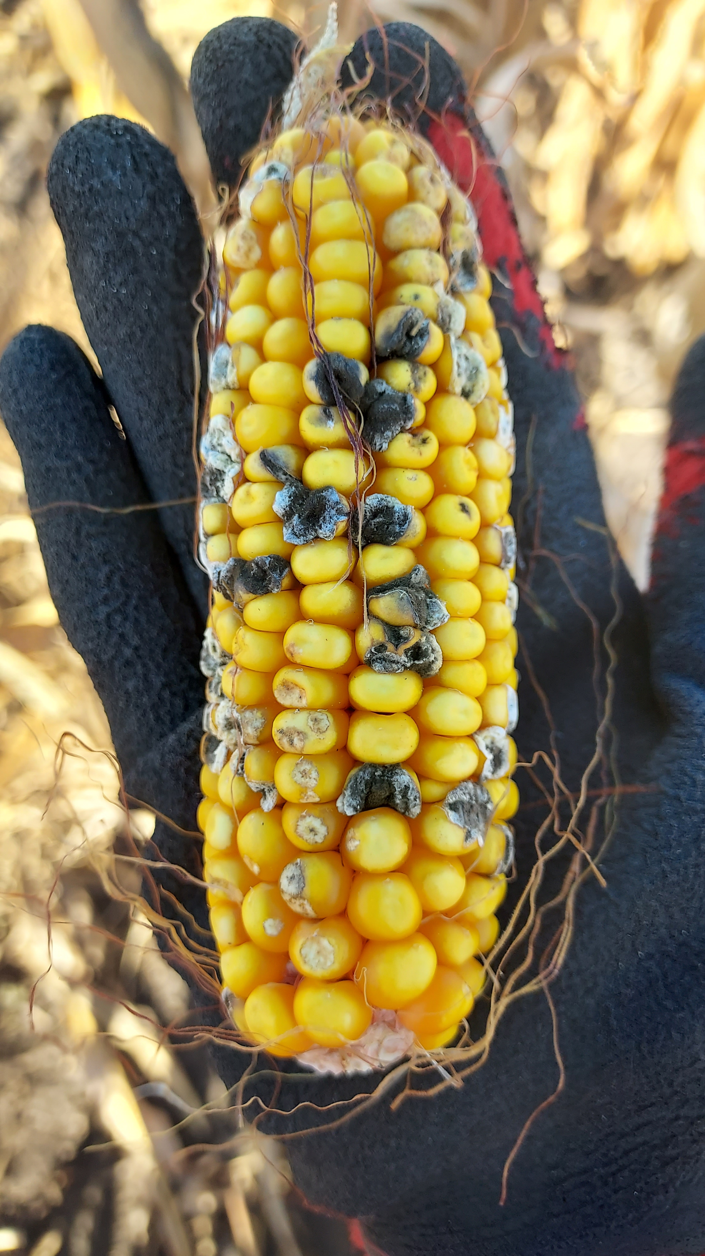
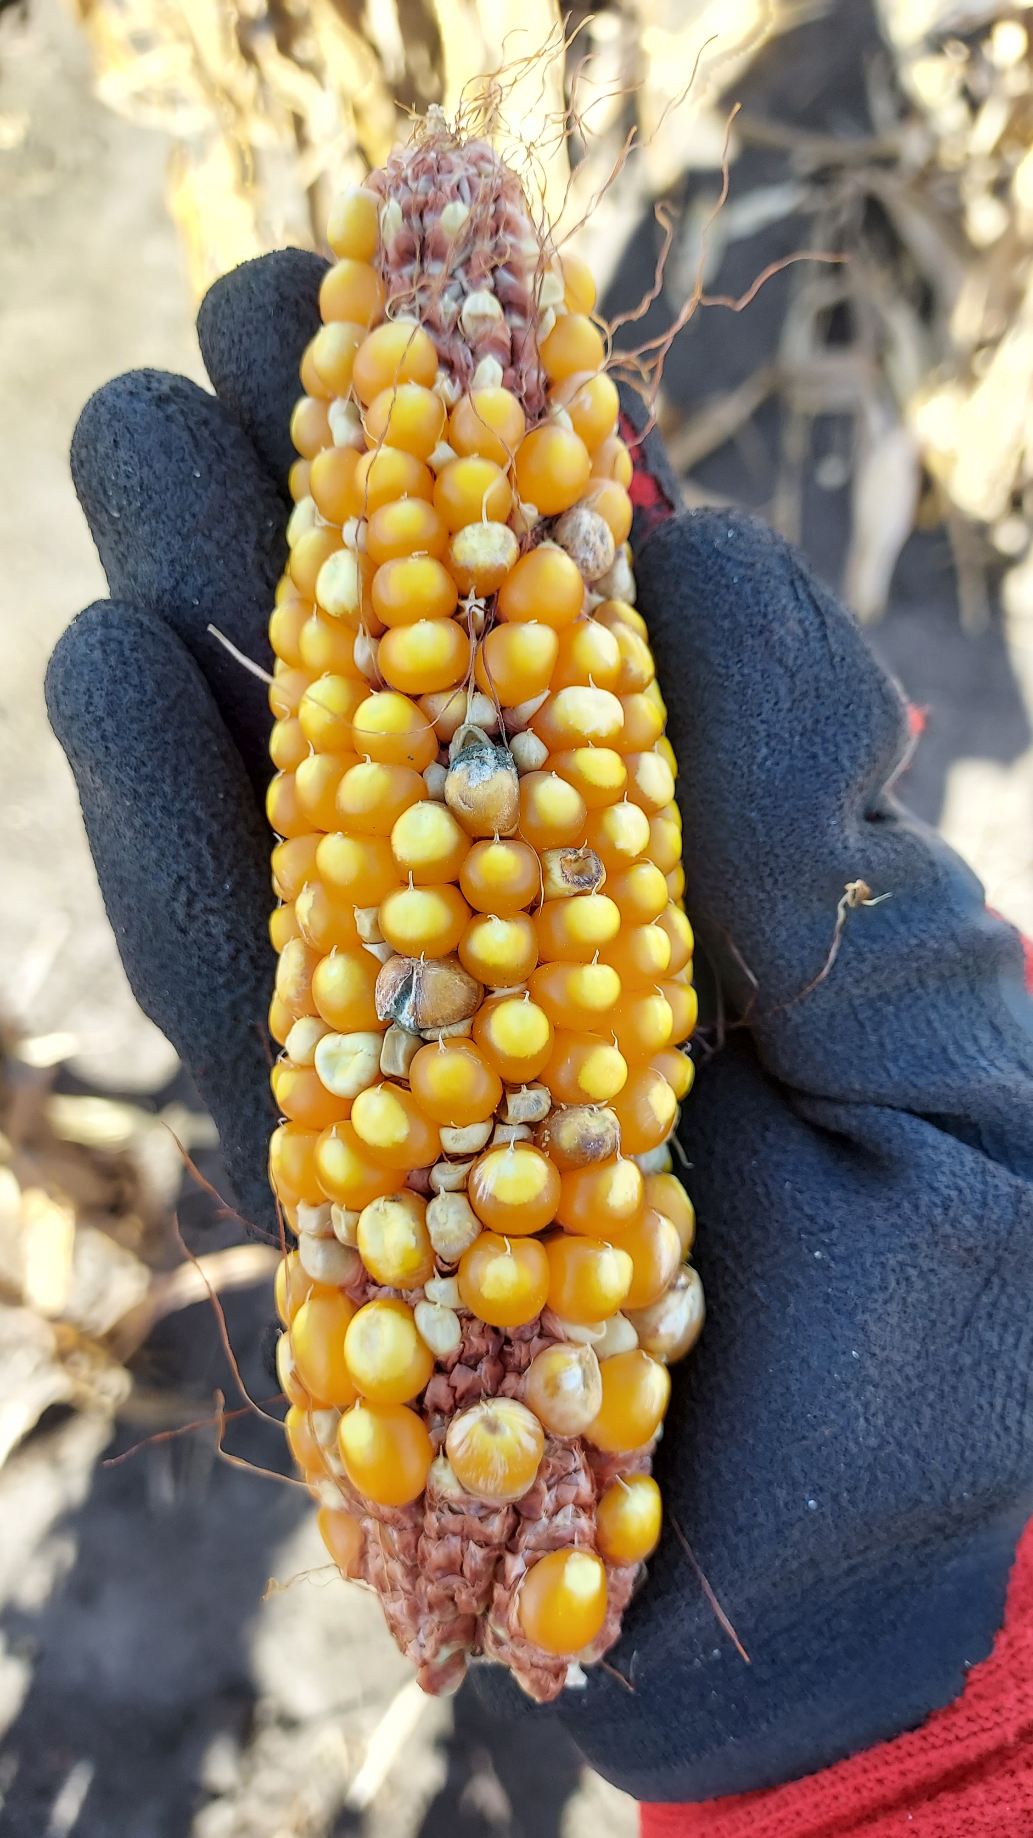
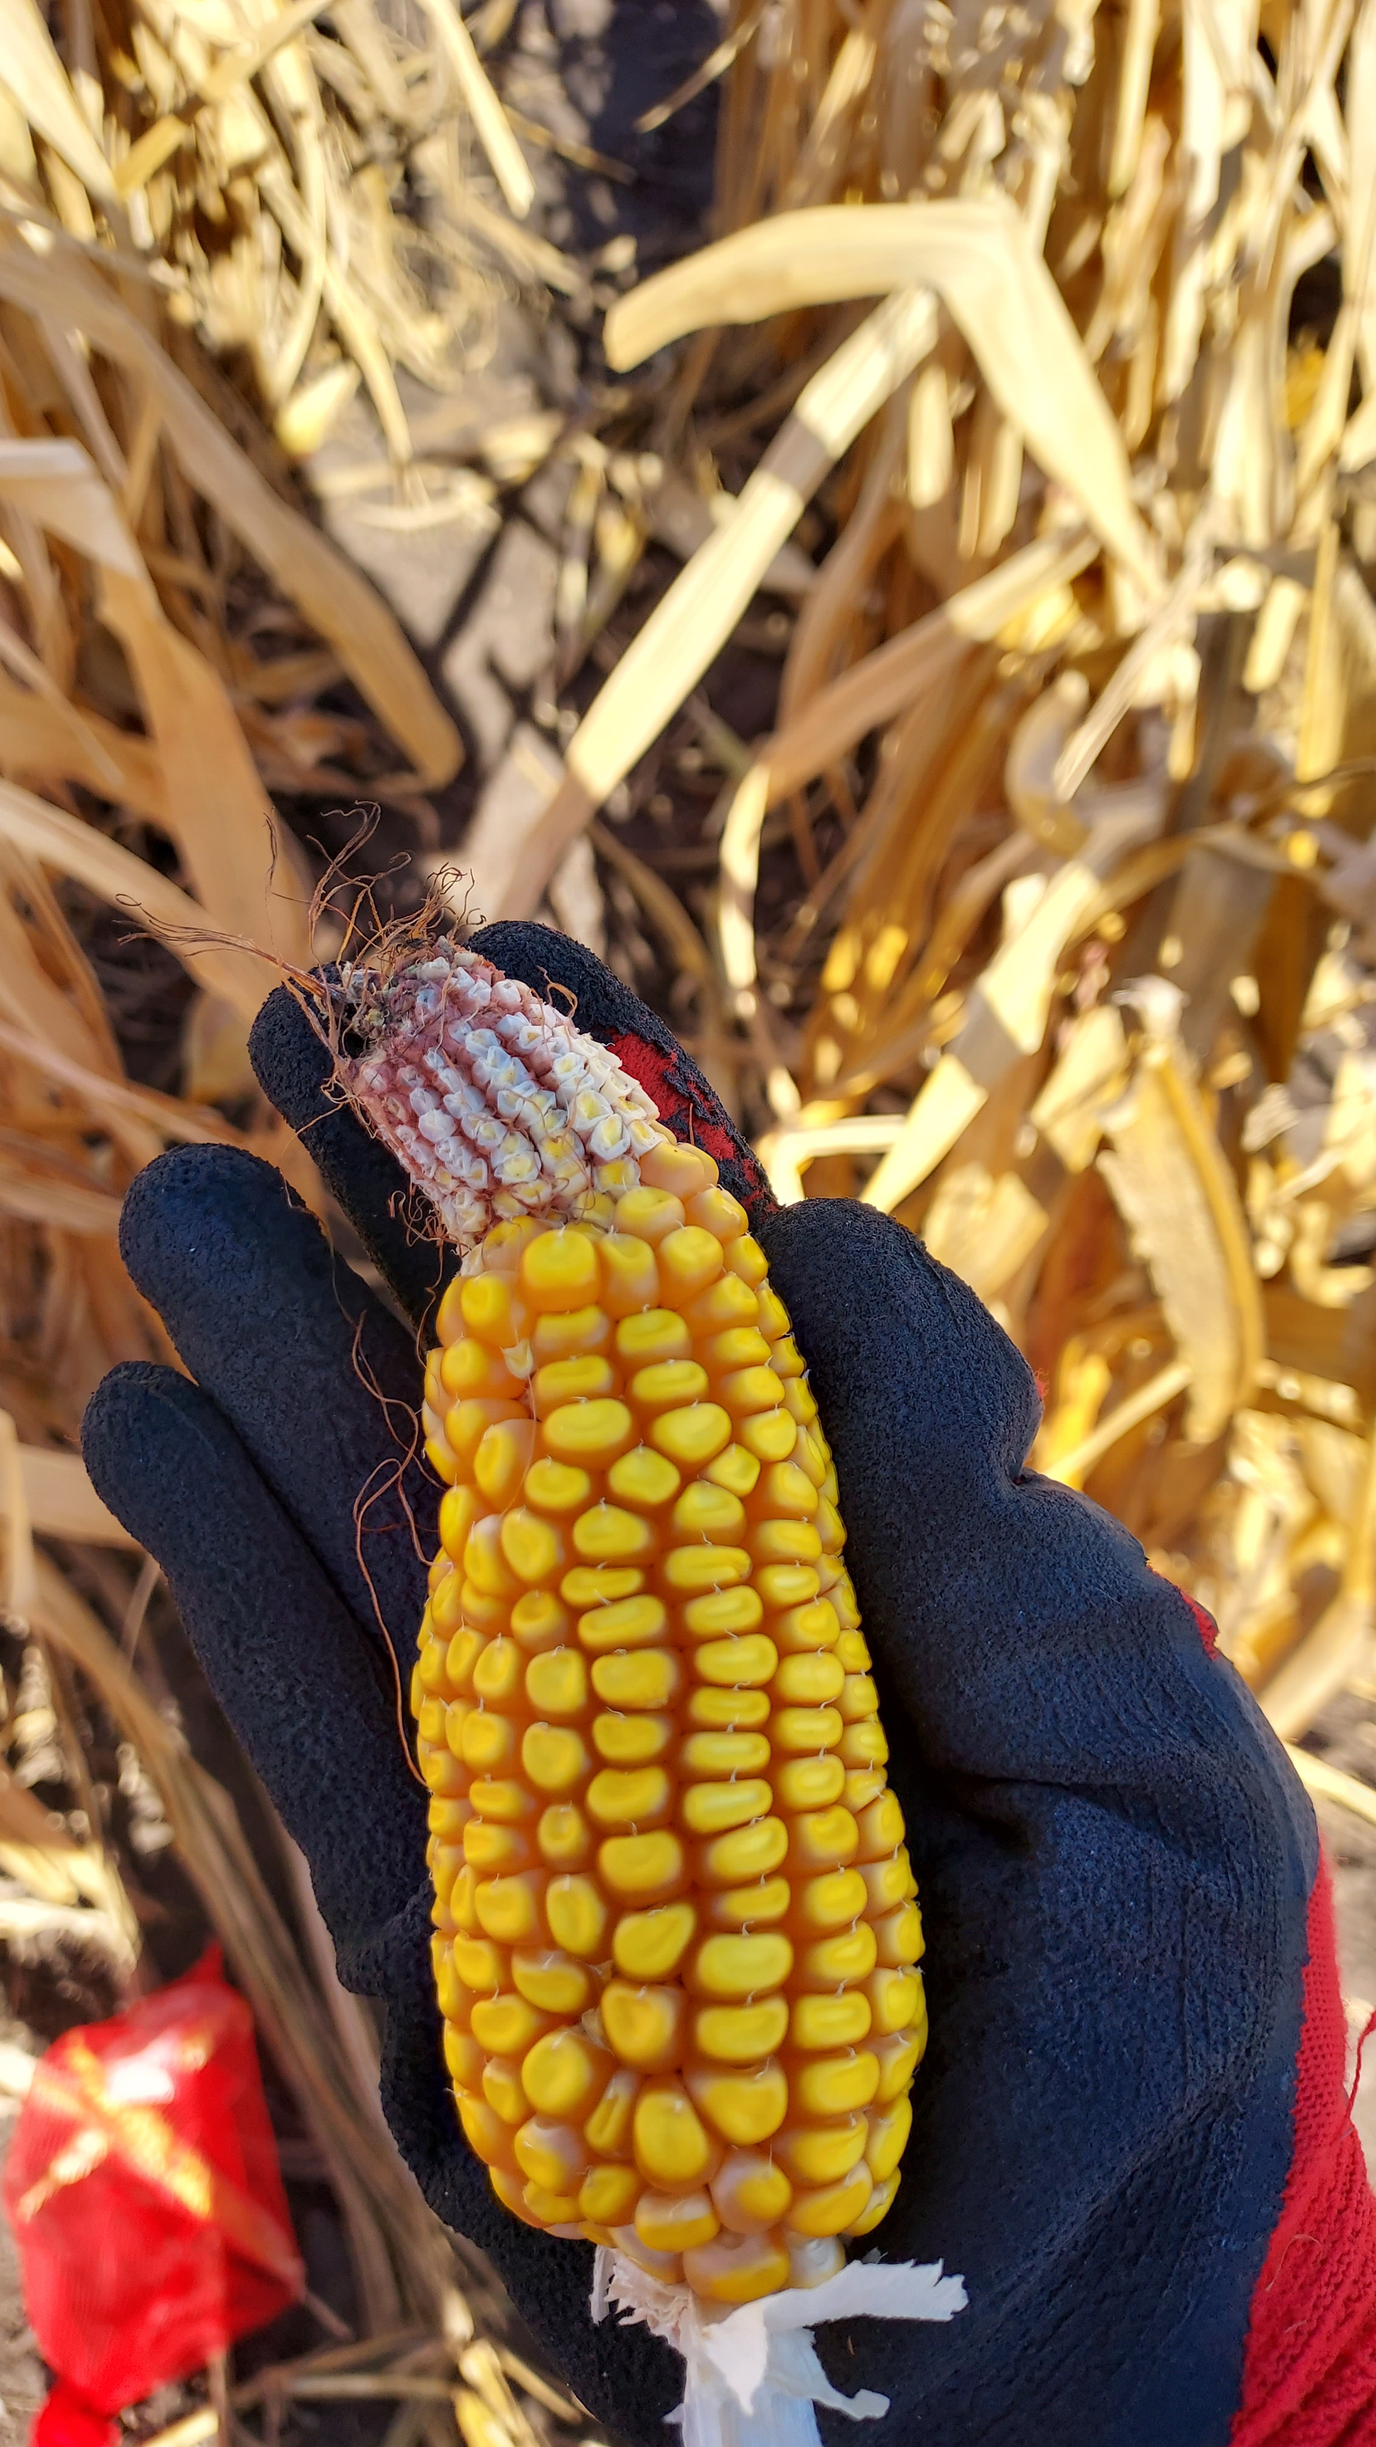
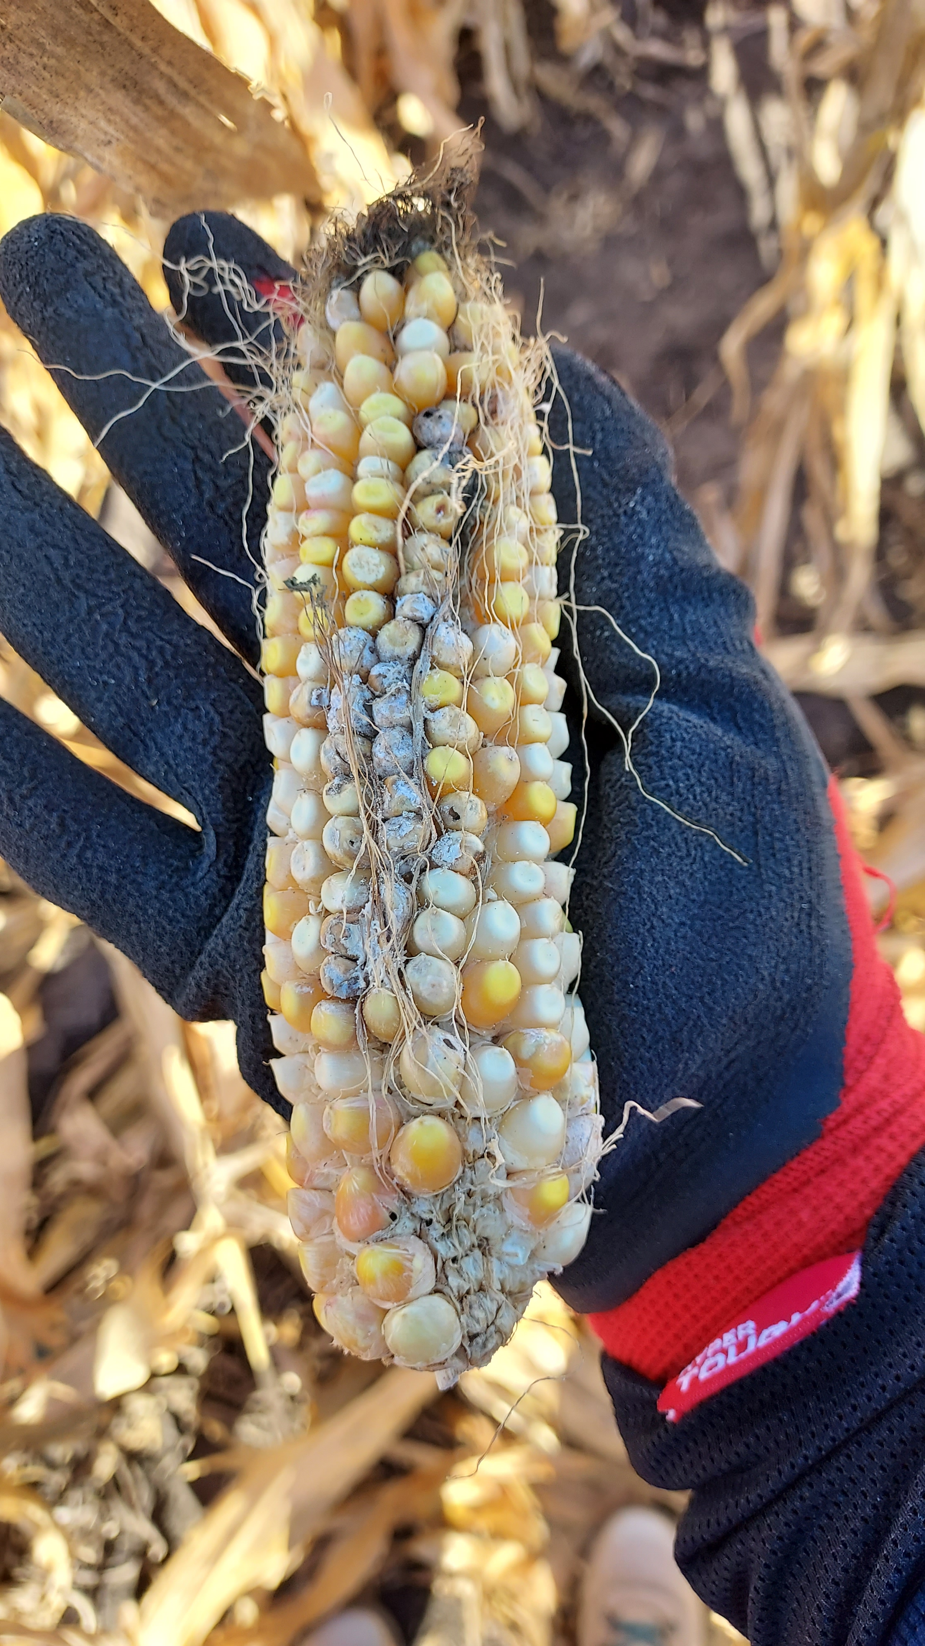
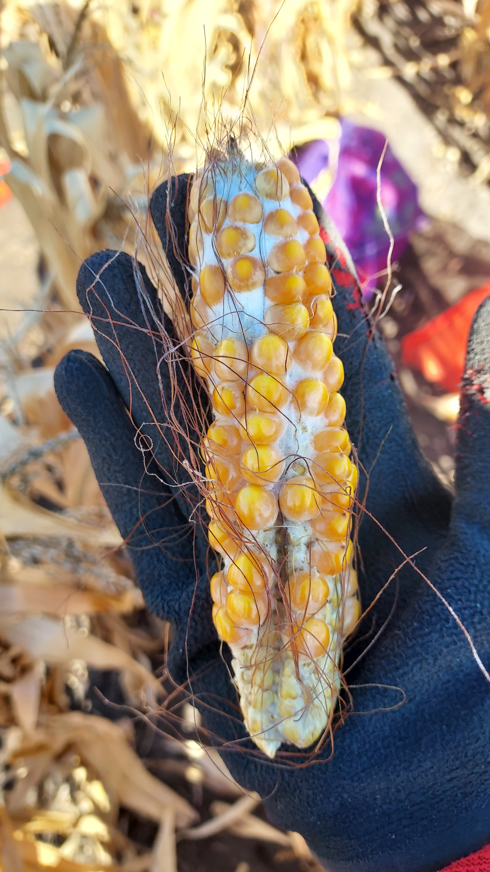
Need to be markered
Ears with large amount of mold/insect damage, or ungrown seeds.
Multi problems
Mold damage
Insect damage
Less seeds

Slide 5
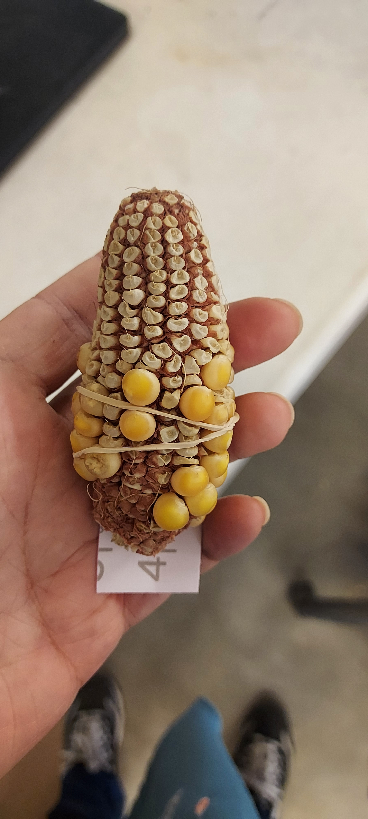
Lethal
Also set aside when >50% seeds are lethal.
Or marker it when affected >25%.
Those seeds did not develop, so the ear (cob) did not grow into its full size.

